Slide 1

ID CARD GENERATION
AUTOMATION
Introduction to
Robotic Process Automation
210701202
RAGAVENDAR K
Mr. DuraiMurugan
Assistant Professor (SG), Department of Computer Science and Engineering

Slide 2
Abstract
ID Card Generation is an efficient solution for automating the
creation of identification cards through the UI Path platform. It simplifies the traditionally time-consuming and error-prone
process by extracting data from different sources and allowing users to customize card designs effortlessly. The bot’s
user-friendly interface enables individuals with minimal
programming or design experience to generate ID cards in
various formats. This project is a time-saving tool for
organizations, including HR departments and educational
institutions, streamlining ID card creation without the need for complex design software or coding skills.

Slide 3
Need for the Proposed System
The proposed system for ID card generation using UI Path addresses the
following key needs:
Simplified ID Card Creation: The existing manual processes for creating
identification cards are often complex and time-consuming. This proposed system simplifies the entire process, making it accessible to users with
varying levels of expertise, without the need for specialized design or
coding knowledge.
2. Automation of Repetitive Tasks: Manual ID card creation involves
repetitive tasks, including data entry and design adjustments, which
consume valuable time and resources. The proposed system automates
these tasks, reducing the potential for errors and saving considerable
effort.
3. User-Friendly Interface: The system provides an intuitive and
user-friendly interface, allowing individuals with minimal design or
programming skills to input data and customize card details easily,
without the need for complex design software.

Slide 4
Advantages of the Proposed System
The ID Card Generation system offers the following key advantages:
01
Time-Saving Solution
The system streamlines the ID card generation process, enabling organizations to create identification cards
quickly and efficiently, saving time compared to
traditional manual methods.
02
Elimination of Manual Commands
Users no longer need to type complex commands in the terminal for ID card generation. The system simplifies
the entire process, making it accessible to users with
minimal technical expertise.
03
Automated File Editing
The system takes care of the necessary file editing tasks, ensuring that every ID card project is set up correctly without manual intervention. This automation minimizes the risk of errors and ensures consistency.

Slide 5
Literature Survey
The "ID Card Generation UI Path" system operates within the context of the UI Path platform and serves as a valuable tool for automating the ID card creation process. While it may not have as extensive a literature background as Django, some key concepts can be
highlighted:
1. UI Path Platform: The system leverages the UI Path platform, which is known for its
capabilities in process automation and robotic process automation (RPA). UI Path
enables the creation of software robots (bots) to automate repetitive tasks, making it a
powerful tool for various industries.
2. Simplified ID Card Generation: Similar to Django's approach to web development, the
ID Card Generation system aims to simplify and automate the process of creating
identification cards. It provides a user-friendly interface that allows users to customize
card designs and data inputs with ease.
3. Automation and Loosely Coupled Components: The system automates the repetitive
tasks associated with ID card creation, following the philosophy of loose coupling. This
approach involves breaking down the ID card creation process into distinct, loosely
dependent components, enabling easy replacement of individual components, similar to the concept of orthogonality in Django's MVC design pattern.

Slide 6
Efficient ID Card Creation:
Eliminate the complexities and manual tasks associated with creating
identification cards. The system streamlines the ID card generation
process, making it accessible to users with varying levels of expertise.
2.Automated Routing and Endpoint Handling:
Automatically handle the routing of endpoints for APIs used in the
ID card generation process. This automation ensures that communication between applications and the ID card generation system is seamless and
well-structured.
3.User-Friendly Terminal Interaction:
Simplify the interaction with the UI Path platform by handling tasks such
as creating new projects or apps. Users do not need to deal with complex terminal commands, reducing the learning curve and the potential for
errors.
4.Effortless API Body Provision:
Provide users with the body of the API, enabling developers to focus on coding the core business logic for their projects. This feature eliminates the need to create a function for each API manually.
Main Objective

Slide 7
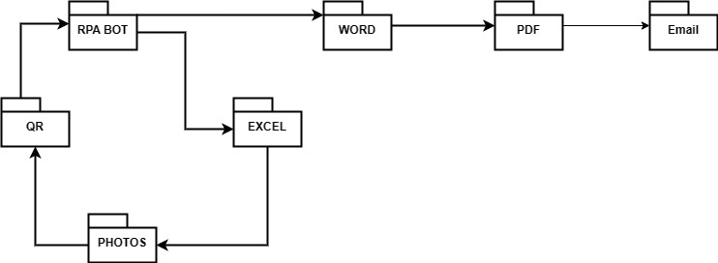
ARCHITECTURE DIAGRAM

Slide 8
System Requirements
Insert the title of your subtitle Here
Hardware
Software
01
Processor – Intel Core i3
01
UiPath Studio
02
EXCEL
02
RAM – 4 GB RAM
03
WORD
03
Hard Disk – 256 GB
04
PDF

Slide 9
Functional Description
Following the creation of an ID card generation app within the UI Path platform, the user can seamlessly transition to defining the logic for their ID card generation process. To facilitate this, the user typically needs to create various functions, each associated with specific events that trigger their execution. The process of function creation initiates with specifying the method type that will be used to call the API (such as get, post, put, delete). Subsequently, the developer defines the function name and its corresponding input parameters. This pattern is consistent across all functions, varying primarily based on the method type.

Slide 10
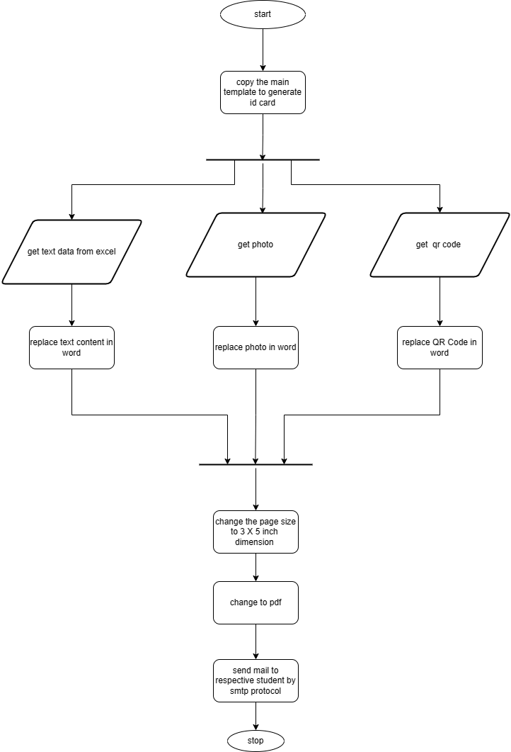
Functional Description
When presented with input, the ID Card Generation UI Path bot efficiently generates these functions, complete with the specified declarations. The generated functions are encapsulated within a try-catch block, ensuring that any errors encountered during execution do not disrupt the overall functioning of the ID card generation system. The bot discerns the method type and appropriately retrieves parameters from the request argument. For post methods, values are extracted from the request . query, whereas for get methods, the values are sourced from the request query . This dynamic approach ensures the generated code aligns with the specific requirements of the API type. The resulting code is seamlessly updated in the relevant files, particularly the views.py file, enabling the developer to focus on the intricate logic associated with ID card generation without getting entangled in the nuances of function declaration and method-specific parameter extraction.

Slide 11
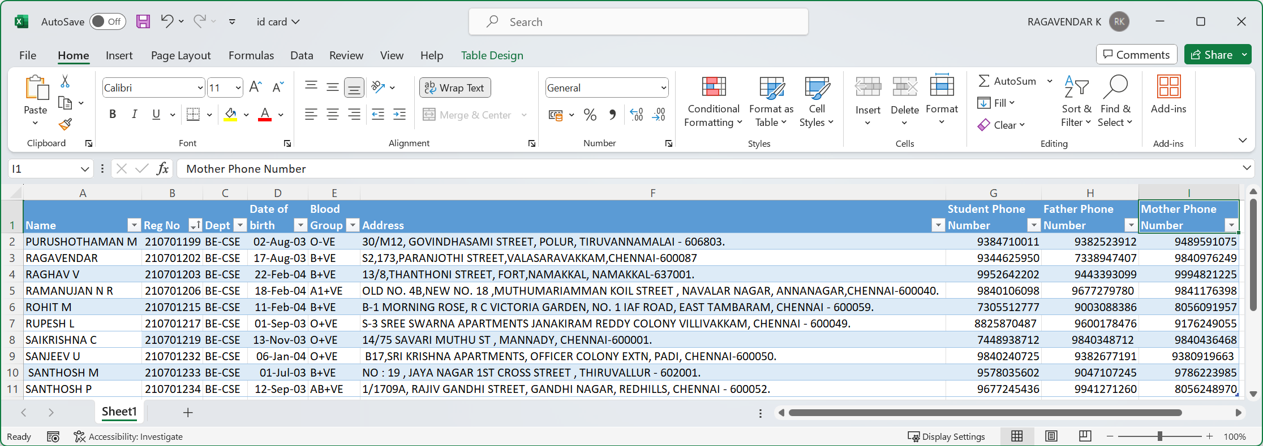
Implementation Module 1
The Bot is set to take the details from excel as input.
The photo ,QR Code and the text is changed by the bot in word application scope.

Slide 12
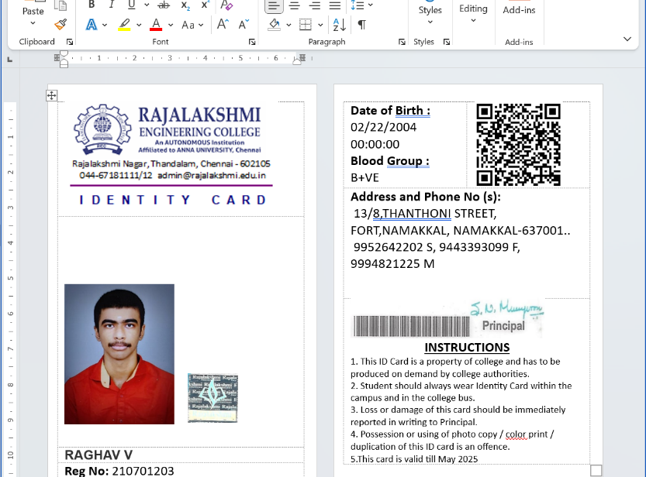
Implementation Module 2
The Bot is set to take the details from excel as input and open word to change the contents .
The photo ,QR Code and the text is changed by the bot in word application scope.

Slide 13
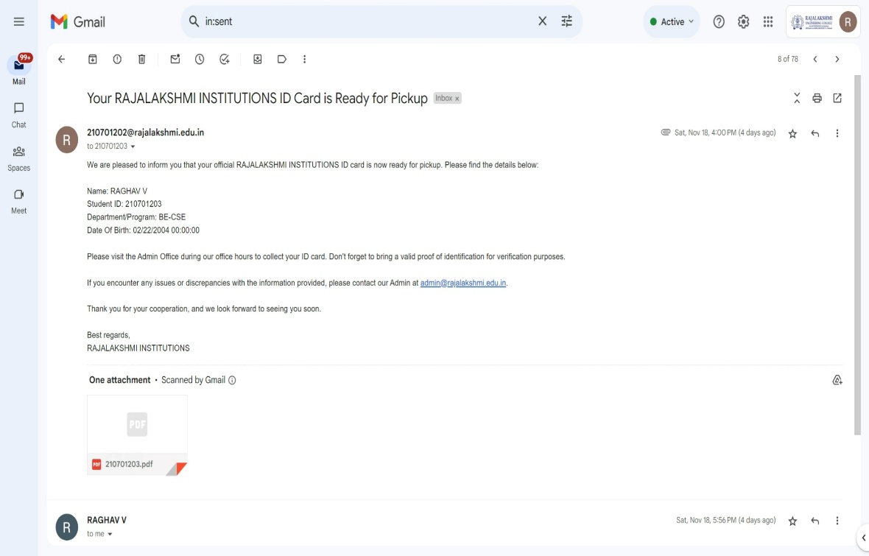
Implementation Module 3
The Bot is set to send mail to receive id card from admin office and send the copy to verify card details.
The respective details are fetch from excel sheet

Slide 14
Conclusions
The ID card generation bot developed with UiPath has proven to be highly efficient and user-friendly. Even developers without prior knowledge of complex frameworks like UiPath can easily create web servers to support mobile, web, or desktop applications using Python. This solution simplifies the development process, requiring only a basic understanding of Python programming. The UiPath-based system ensures a smooth and accessible entry point for developers looking to embark on their ID card generation projects without the need for extensive expertise in more intricate technologies.

Slide 15
Future Enhancement
Automated Testing
 | Streamline the database integration process by incorporating automated connections within the bot. This enhancement will optimize data retrieval and storage, contributing to a more seamless ID card generation experience.
Automated Testing
 | Implement automated testing functionalities within the bot to validate its performance with standard inputs. This ensures robustness and reliability, reducing the likelihood of errors during the ID card generation process.
Framework Expansion
 | Extend the capabilities of the bot beyond the Django framework. By accommodating additional frameworks, the bot becomes a versatile tool, catering to a broader range of developer preferences and project requirements.

Slide 16
References
In the development of the ID card generation project using UiPath, the following references were consulted:
Microsoft Word:
Microsoft Corporation. (n.d.). Official Microsoft Word Documentation. https://support.microsoft.com/en-us/word
PDF Handling:
Adobe Inc. (n.d.). Adobe PDF Documentation. https://www.adobe.com/acrobat/pdf.html
Excel Integration:
Microsoft Corporation. (n.d.). Microsoft Excel Documentation. https://support.microsoft.com/en-us/excel
UiPath Automation Platform:
UiPath. (n.d.). UiPath Documentation. https://docs.uipath.com/
These references provided valuable insights into the functionalities and best practices associated with Microsoft Word, PDF, Excel, and UiPath, contributing to the successful implementation of the ID card generation project.

Slide 17
Thank you
Insert the title of your subtitle Here

